Slide 1

Open-source in Finance

Slide 2



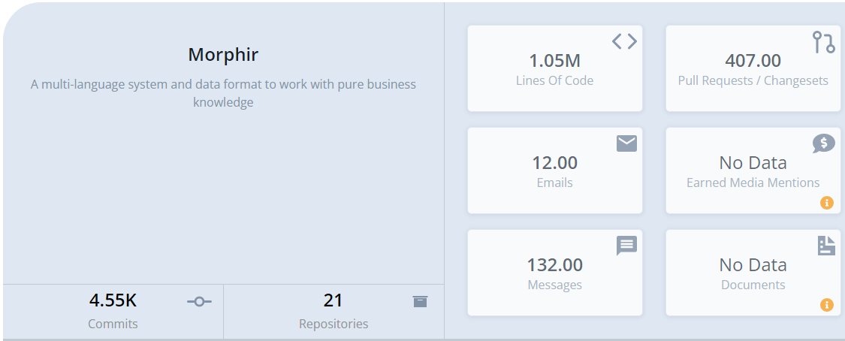
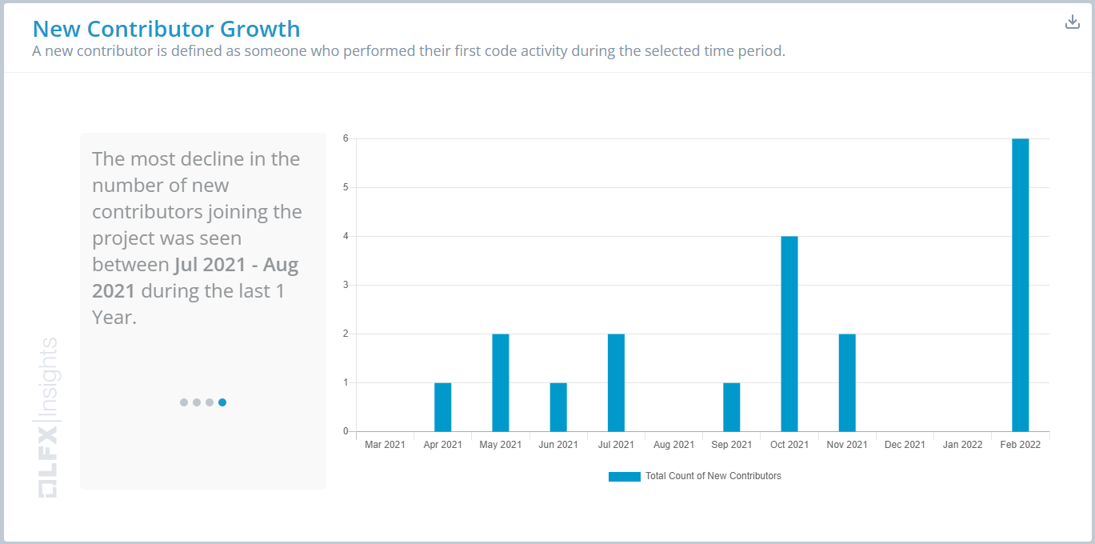


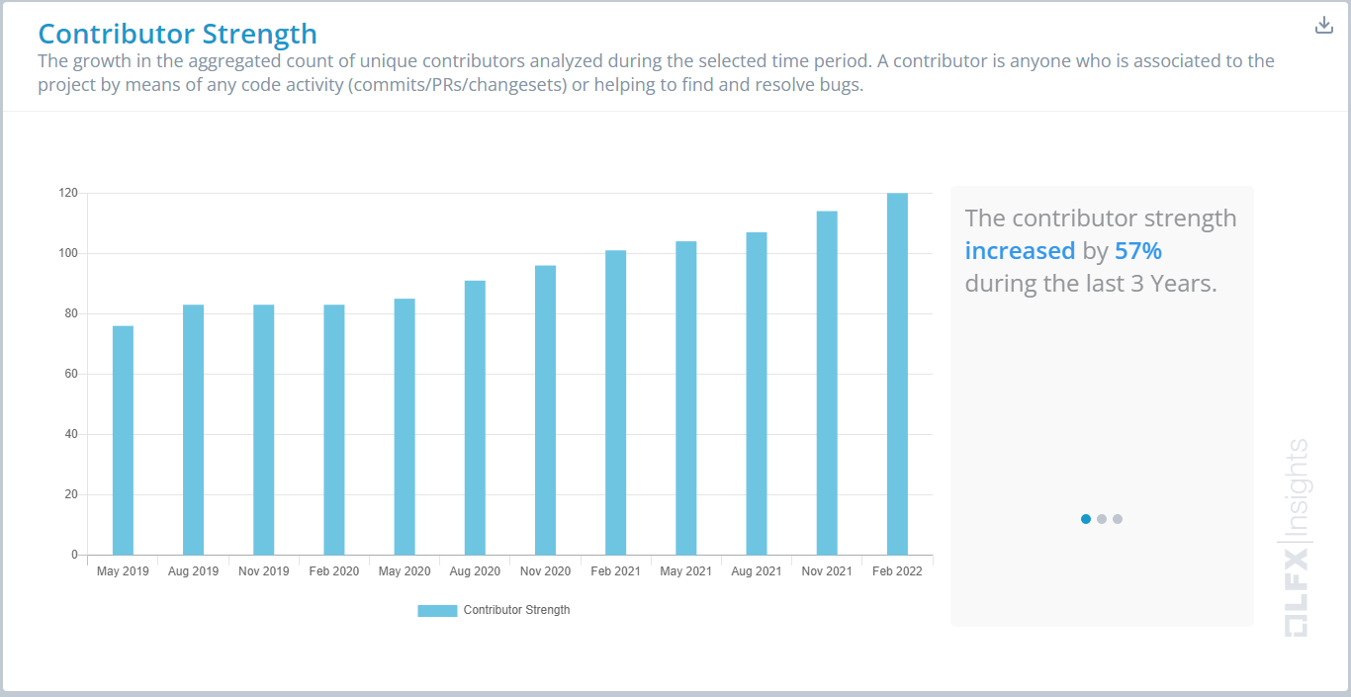
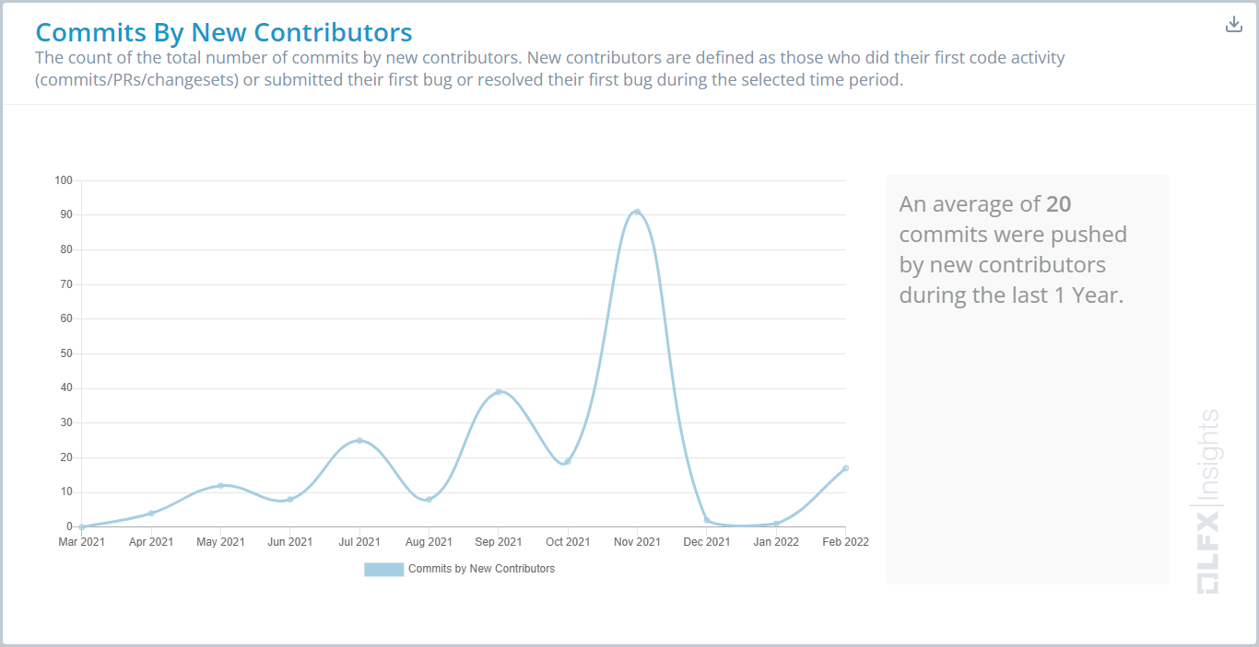
Project
Stephen Goldbaum
Morgan Stanley Executive Director

Slide 3
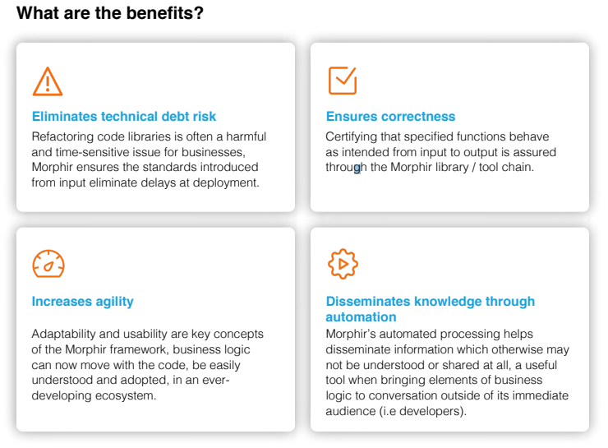
Motivation
Industry-wide Transformation
More automation
Faster tech advances
More citizen involvement
Increased Transparency
Regulatory requirements
Easy to investigate and understand
Audits
Ensure correctness
Be Better
Work faster
Reduce risk
Increase efficiency
Open Source
Access to talent
Smoother execution
Makes good business sense

Slide 4
Motivation

Slide 5




The Morphir Experience
Inefficient
Write spec
Study spec
Design code
Implement code
Document code
Integrate (data dictionary, etc.)
Test
Redo as needed
Deploy
Redo as needed
Efficient
Collaborate on spec using Morphir
Generate
Test
Deploy

Slide 6
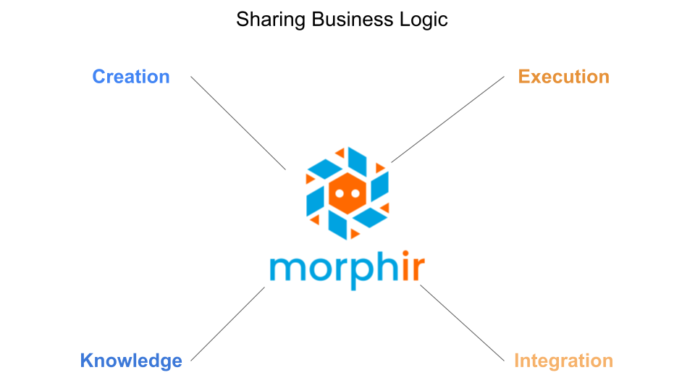

Slide 7
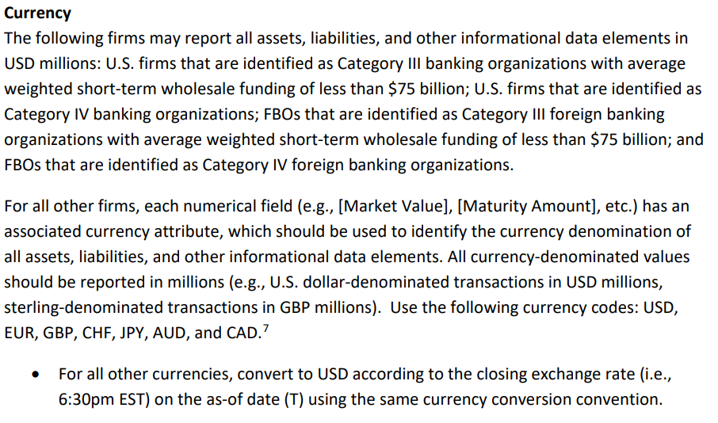
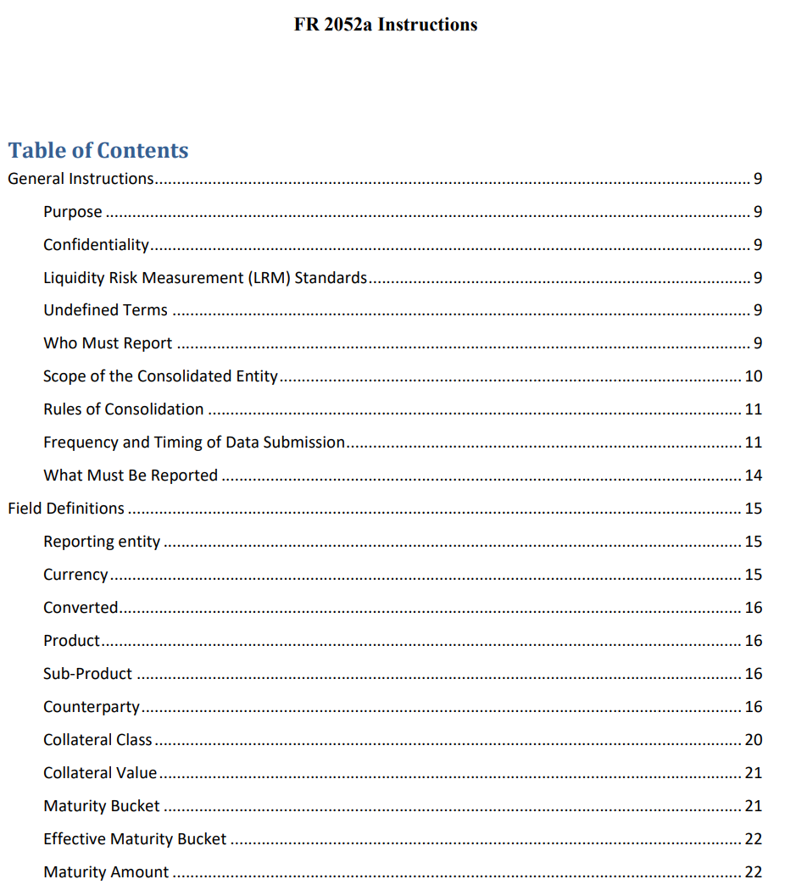
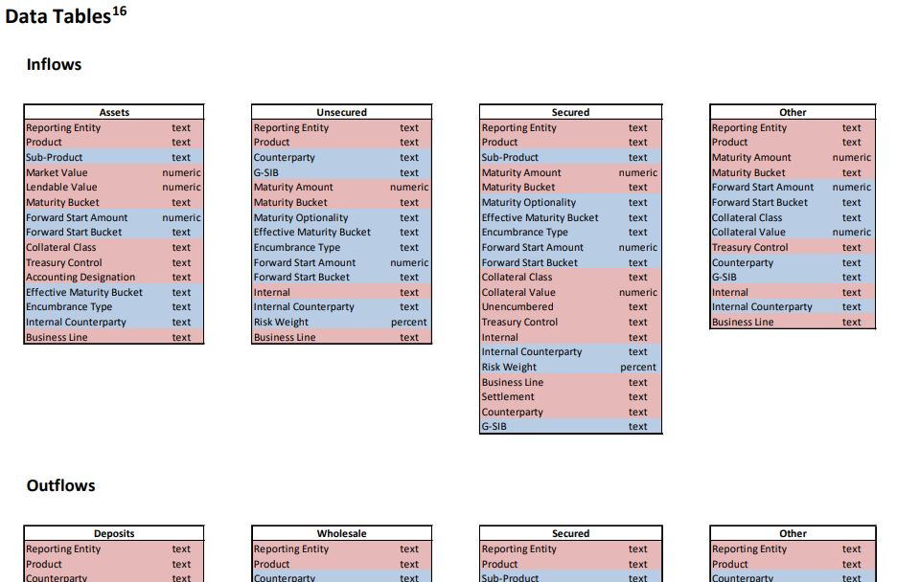
Creation

Slide 8
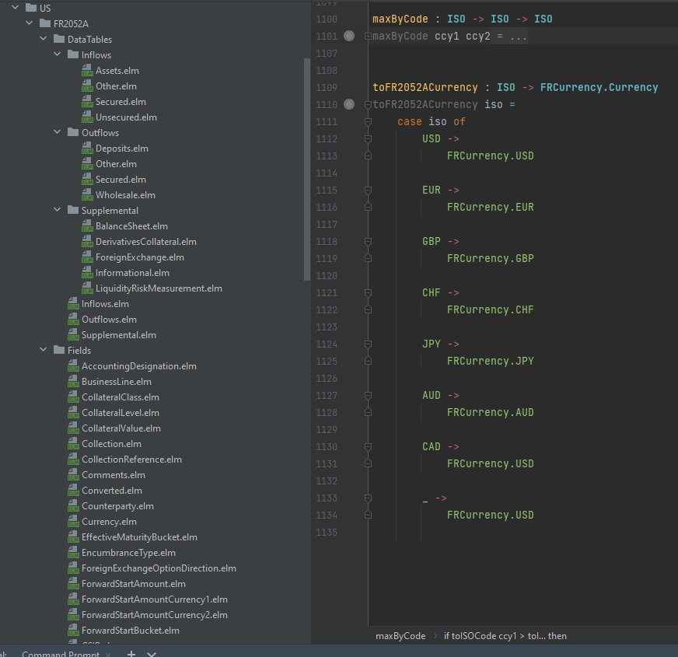
Creation: Spec = Code / Code = Spec

Slide 9








Creation: Open Source
Native
Elm
DSL
Open Source
Elm
Bosque
Legend
Scala
Rosetta
TypeScript
F#
Bosque Programming Language

Slide 10
Creation: Other Open-source Ideas
SQL
ETL
DAGS (Spark, BEAM, Jet, etc.)
OCaml
Rules engine DSLs
Excel
Low Code / No Code
…
There’s business logic in all of these. If we can extract it, we can do great things.

Slide 11
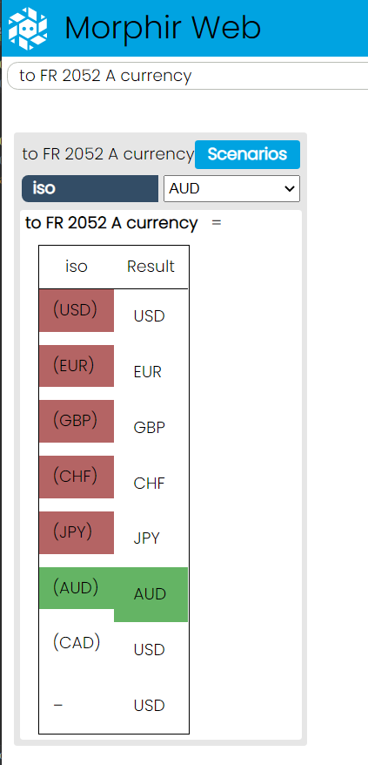
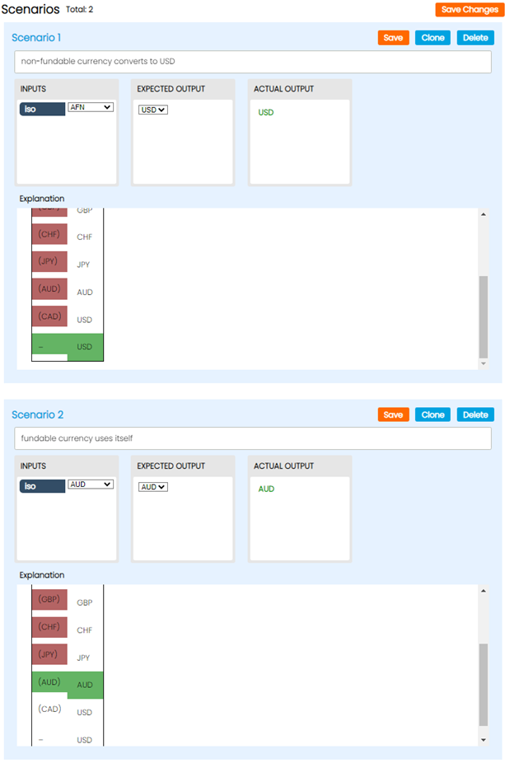
Quality: Interactive Knowledge Share

Slide 12
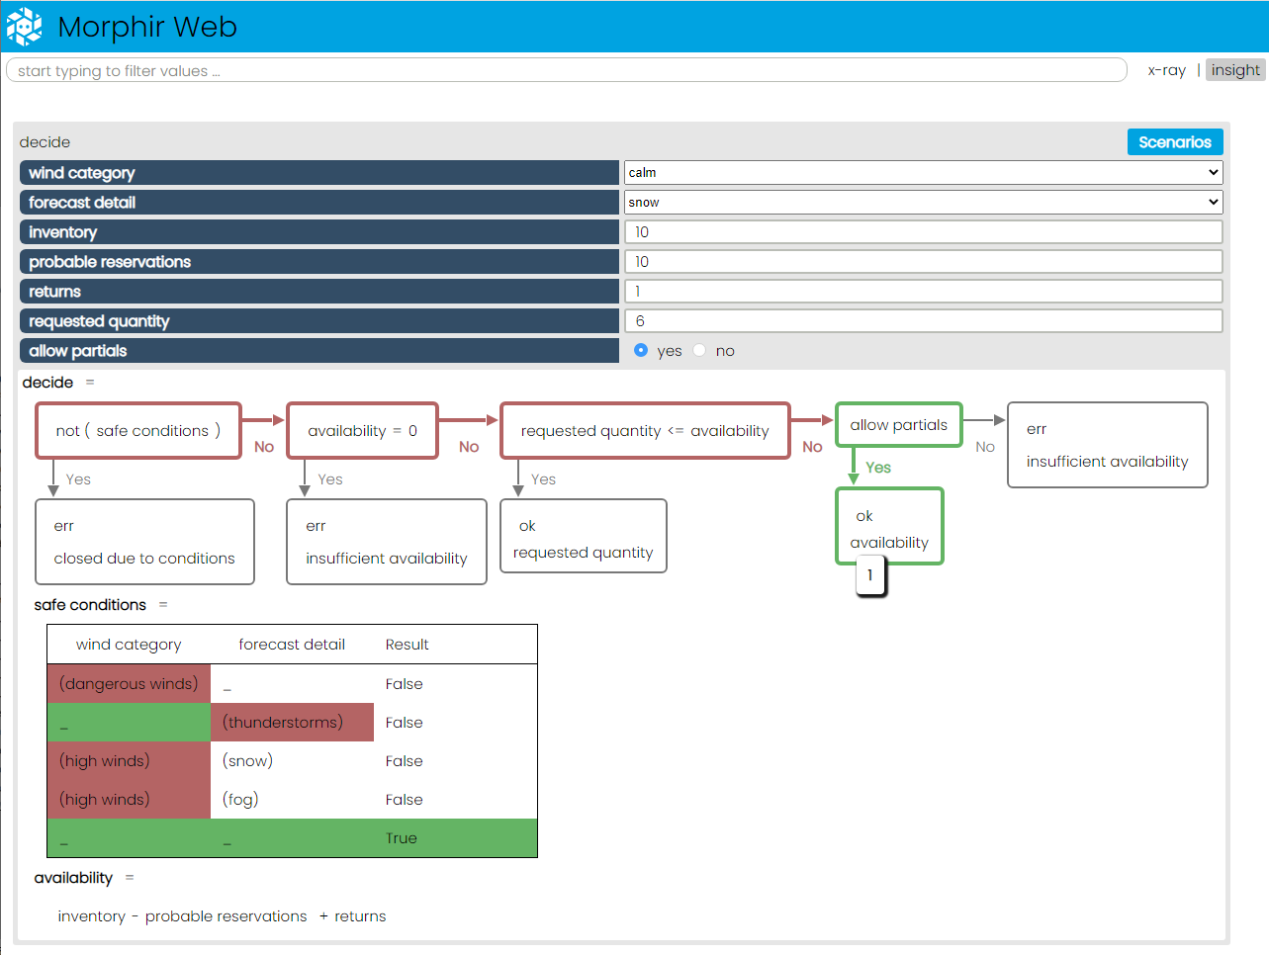
Knowledge: Audit
Why’d it do that?

Slide 13
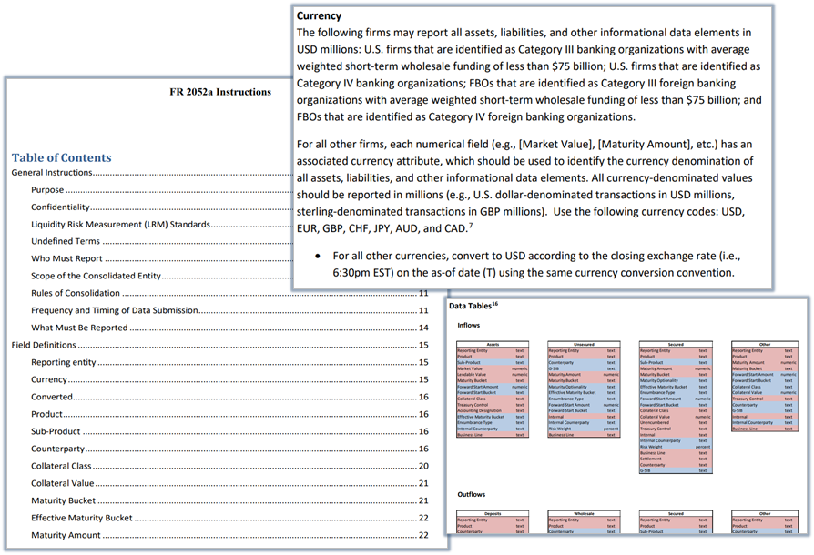
Anti-knowledge

Slide 14
Anti-knowledge: Fragmentation

Slide 15
Knowledge: Holistic
Notes:
Business users can’t understand from code
Neither can we!
Forensics exercise

Slide 16

Quality & Knowledge
Native
100% Pure business logic
Insight
Test
Audit
Graph
Open-source
Elm / functional compiler
Bosque verification
Legend / Morphir / Bosque integration project
POPL 2022 Conference and Paper
Bosque Programming Language

Slide 17
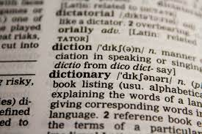
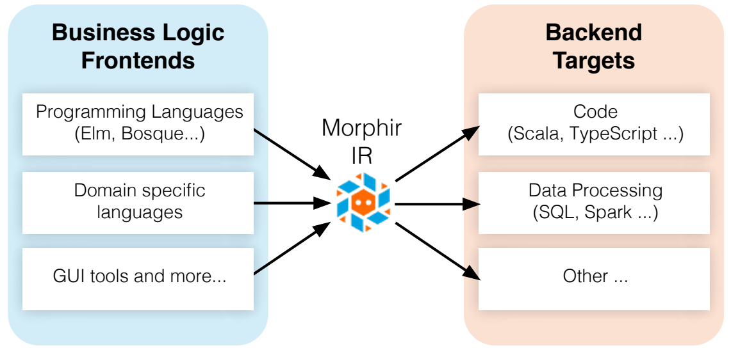
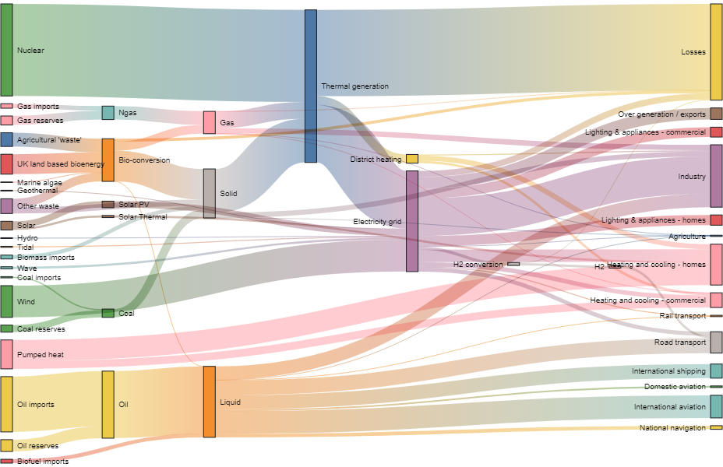

Integration
Data Dictionary
Data Lineage
Data Quality

Slide 18
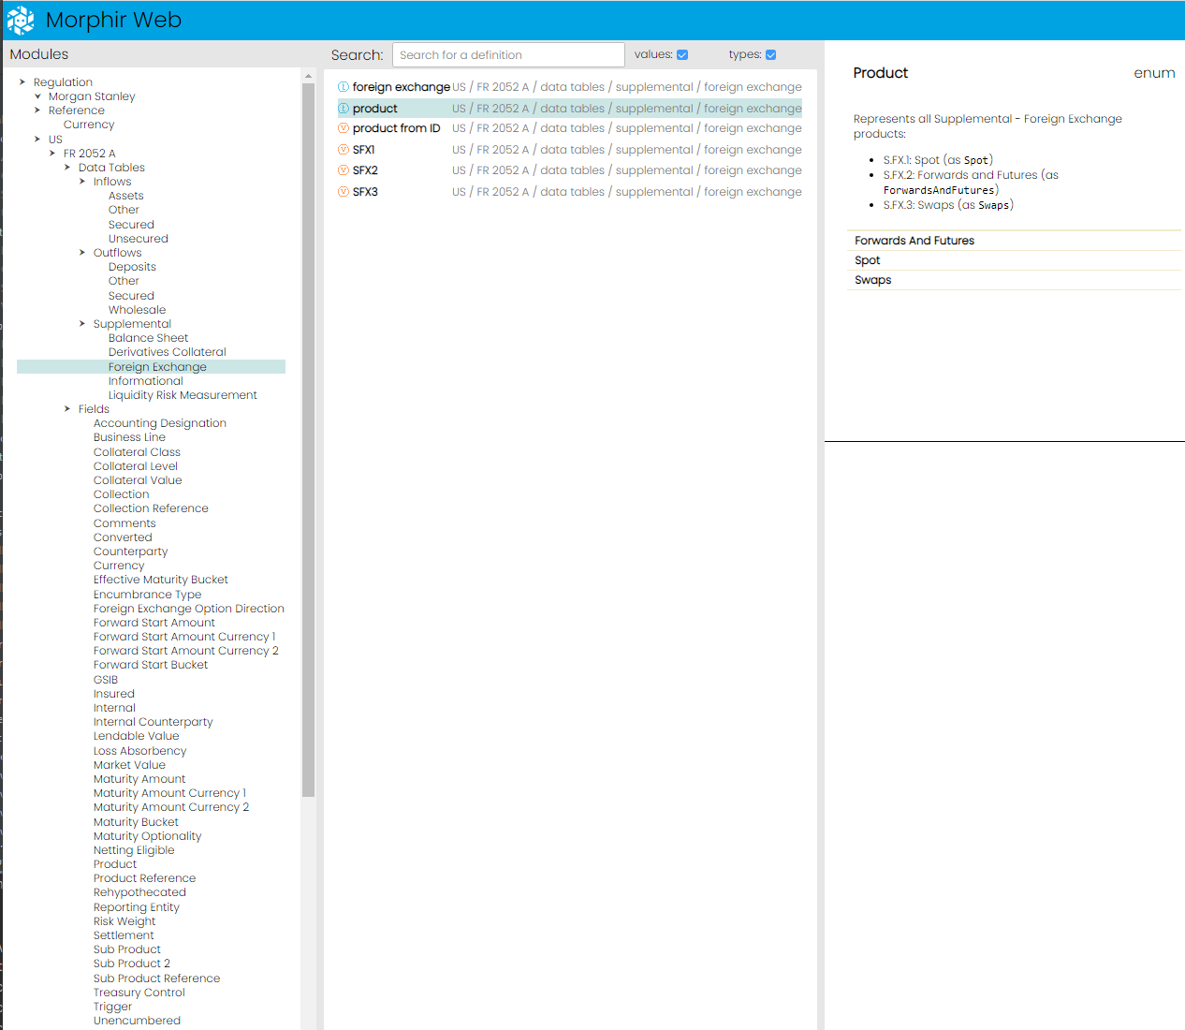
Integration

Slide 19





Execution
Native
Scala
JavaScript
Interpreted
Spring
Open-source
Dapr
Spark
…

Slide 20
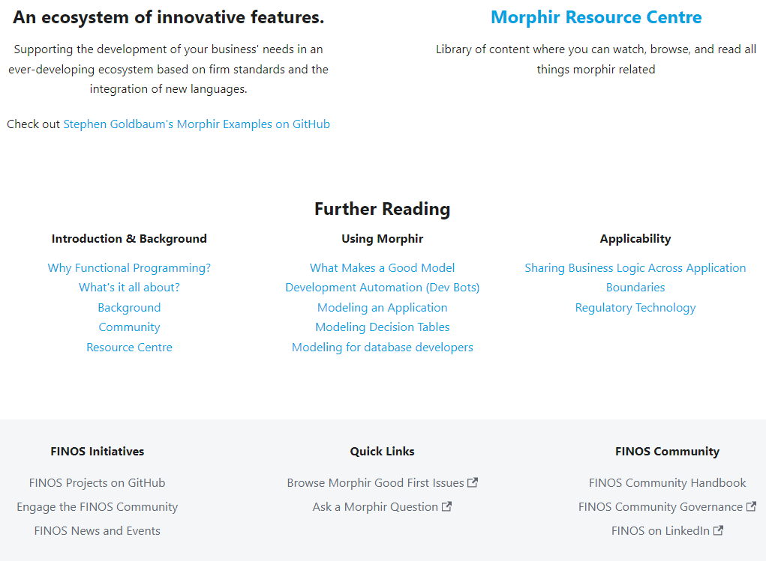
Open-source Success
Incredible partnerships
Incredible potential
Roadmap
Execution
Spark
Microservice
Creation
Scala and more…
Quality
More insight
More Bosque verifier
Integration
Data Management & Data Quality
Ontologies & semantic
Get Involved
Your creativity

